Slide 1
General Session 2

Slide 3
Lunch

Slide 4
DALE BASHAM
Emcee

Slide 5
Dr. Kenneth Holland
6560

Slide 6
Educating Leaders in Nations Struggling to be Free
Dr. Kenneth Holland
President Emeritus
American University of Afghanistan
Presentation to Rotary Land of Lincoln President-Elect Training Seminar
March 18, 2023
Effingham, IL

Slide 7
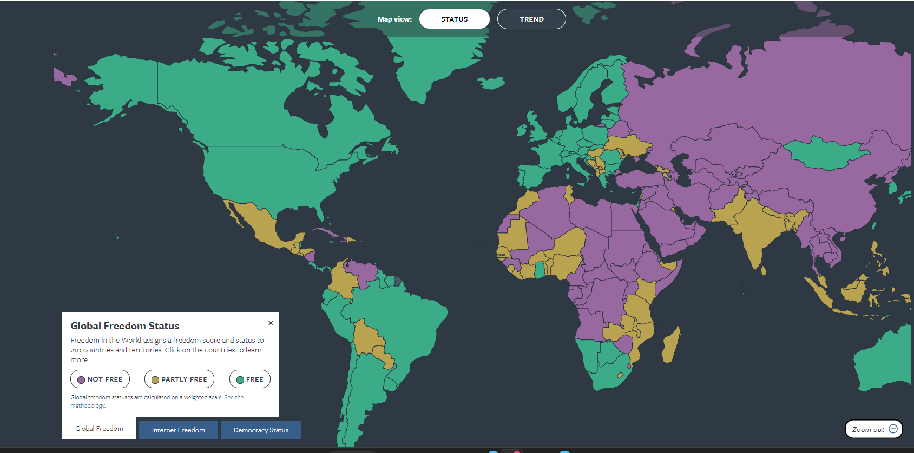

Slide 8
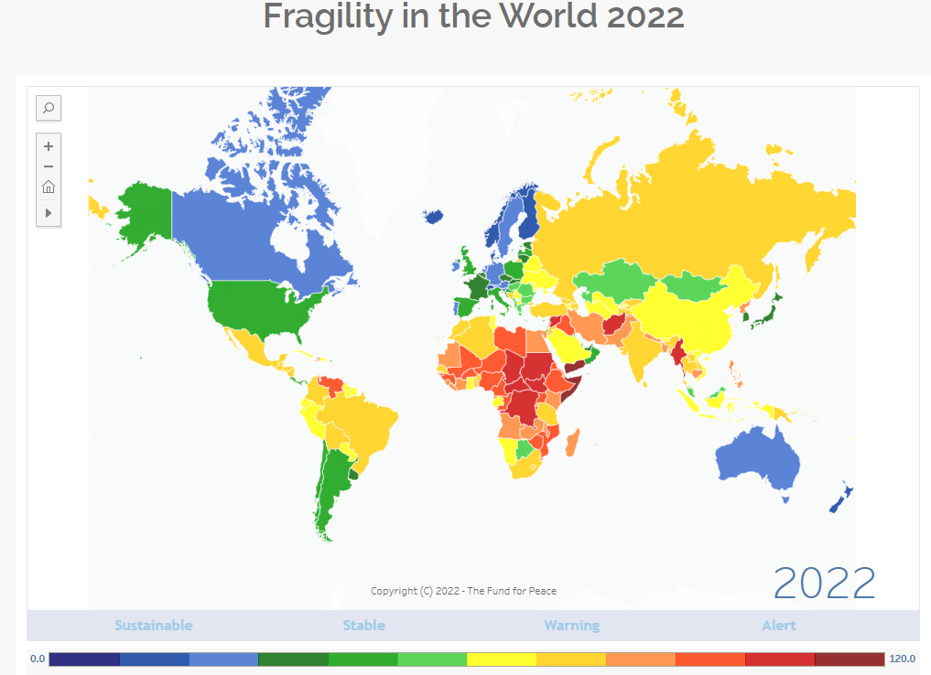

Slide 9
Office of Transition Initiatives (OTI) United States Agency for International Development (USAID)
OTI supports U.S. foreign policy objectives by helping local partners advance peace and democracy.
OTI provides fast, flexible, short-term assistance targeted at key political transition and stabilization needs.
OTI promotes reconciliation, supports emerging independent media, and fosters peace and democracy through innovative programming.
In countries transitioning from authoritarianism to democracy, from violence to peace, or following a fragile peace, OTI’s programs serve as catalysts for positive political change.

Slide 10
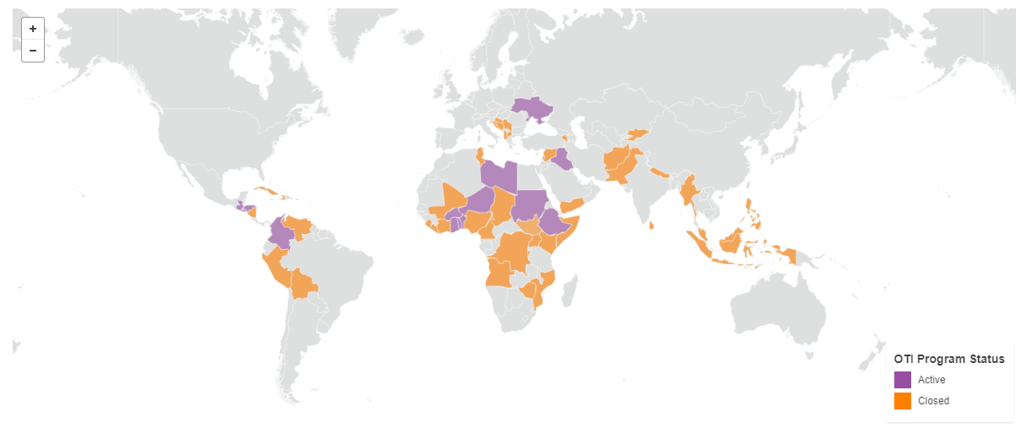

Slide 11
Transition to Democracy is Gradual
Transition from authoritarianism to democracy typically takes more than 25 years.
This is the time it takes to educate a new generation of leaders.

Slide 12
Countries Where I Have Helped Develop Higher Education
Afghanistan
Tajikistan
Uzbekistan
Russia
China
Mongolia
Cambodia
Vietnam
Thailand
Myanmar
Bangladesh
Indonesia
Nepal
India
Pakistan
Costa Rica
Iraq
Iran
Kuwait
United Arab Emirates
Saudi Arabia
Mozambique
South Africa
Tunisia
Libya

Slide 13
My Efforts to Educate Leaders in Four Developing Countries
Country | Total Freedom Score | Political Rights | Civil Liberties | Active Years for Me | Sponsor
Afghanistan | 10 Not Free | 17 | 23 | 2006-2019 | World Bank U.S. State Department United States Agency for International Development (USAID)
Iraq | 29 Not Free | 16 | 13 | 2010-2021 | U.S. State Department
Myanmar | 9 Not Free | 0 | 9 | 2013-2017 | U.S. State Department Henry Luce Foundation
Pakistan | 37 Partly Free | 15 | 22 | 2013-present | U.S. State Department

Slide 14
My Speech to First-Year Students at the American University of Afghanistan
The mission of the American University is to educate the future leaders of Afghanistan, in both the private and public sectors, so that Afghanistan will be a country where:
Women are equal to men
The government is accountable to the people through free and fair elections
All people enjoy the civil liberties of freedom of speech, freedom of the press, and freedom of religion
The economy is powered by a free market
All people enjoy the civil rights of freedom from discrimination based on race, ethnicity, gender or religious affiliation and the right to vote
Government is free from corruption and abuse of power

Slide 15
Hope for Democracy in Iraq
I managed higher education development projects in Tikrit and Baghdad and in 2020 was selected by the Iraqi Ministry of Higher Education to train more than 900 university teachers in how to teach their courses online.
The revolution that began in Iraq in 2019, known as the Tishreen movement, represents an indigenous democratization movement.
In place of a social contract based on ethno-sectarian division, protesters called for a civil state based on a unitary Iraqi national identity.
OTI supports Iraq’s democratic consolidation through the Iraq Provincial Elections Activity (IPEA).

Slide 16
Hope for Democracy in Iraq
Iraq’s 2021 national parliamentary elections were widely considered to be the cleanest, most credible in the country’s history.
Through U.S. and international investment, the United Nations provided vital technical support and monitoring assistance that bolstered the integrity and transparency of the process.
A key takeaway from that experience is that this type of international support needs to start early, engaging the public as soon as possible to encourage new candidates to run and to bring voters to the polls.
Free and fair elections are essential for Iraq’s democracy and stability, and U.S. support is critical to ensuring the credibility of the polls.

Slide 17
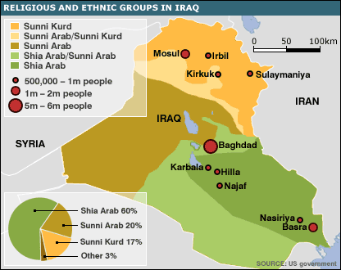

Slide 18
Myanmar The Yangon School of Political Science
The U.S. State Department awarded me a Fulbright Specialist Grant to build the capacity of the Yangon School of Political Science in Myanmar (known by the United States as Rangoon, Burma)
YSPS was founded by former political prisoners
I gave lectures on democracy to social and pro-democracy activists
After many of them were elected to the Myanmar parliament in 2015 as members of the National League of Democracy (NLD), led by Nobel Peace Prize winner Aung San Suu Kyi, I trained them in parliamentary procedure and the duties of a Member of Parliament (MP)

Slide 19
Hope for Democracy in Myanmar
The military seized power after the NLD won a second landslide victory in the 2020 election.
The resulting civil war has killed thousands of civilians and forced 1.5 million people from their homes.
Aung San Suu Kyi is serving a term of more than 30 years in jail.
Many pro-democracy activists, some of whom were imprisoned by previous military governments and were my students at YSPS, are in hiding and working to overthrow the military dictatorship.
The United States and its allies have imposed sanctions on Burma’s military regime.

Slide 20
U.S. Department of State Press Release, January 31, 2023
“The United States will continue to support the pro-democracy movement and its efforts to advance peace and multiparty governance in Burma. We commend those working to strengthen unity and cohesion among diverse groups who share a vision of a genuine and inclusive democracy in Burma.”
The United States, as a partner with the international community, seeks to “intensify diplomatic and economic pressure against the military, and support a peaceful, democratic, and prosperous Burma.”

Slide 22
Pakistan’s Evolution toward Liberal Democracy
Since the general election of 2008 Pakistan has made impressive progress in building a modern liberal democracy.
Pakistan’s position in the Fragile States Index improved from ninth place in 2006 to 30th in 2022.
In Freedom House’s Freedom Index, Pakistan rose from “Not Free” in 2000 to “Partly Free” in 2022.
2018 witnessed the third consecutive election where a democratic handover of power was observed.
All indications are that the 2023 general election will be held in accordance with the constitution.

Slide 23
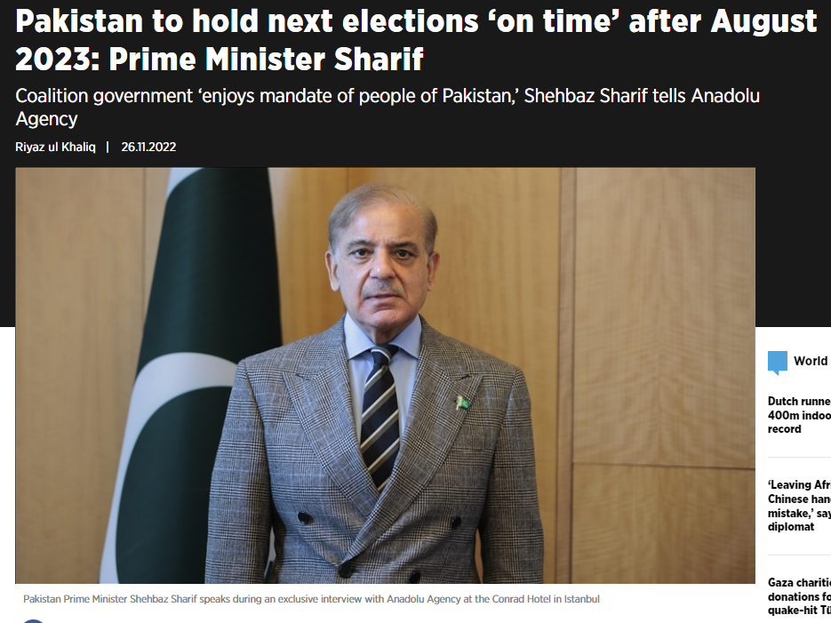

Slide 24
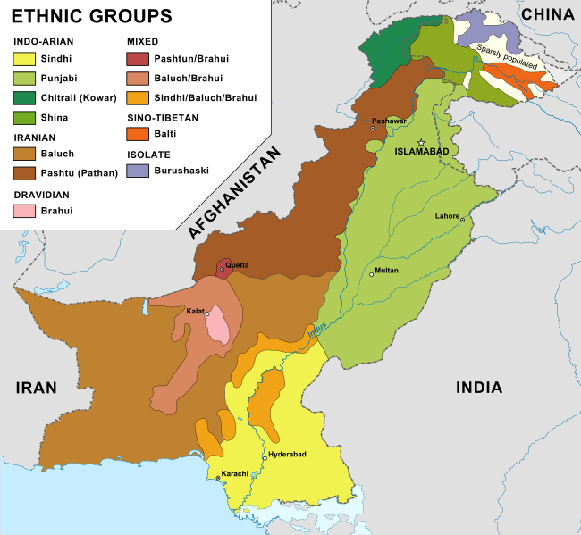

Slide 25
Hope for Democracy in Afghanistan
The Taliban seized power following the U.S. withdrawal in August 2021.
The Taliban de facto government has barred girls from education above grade six and women from higher education.
Women are barred from employment.
Twenty million Afghans are in crisis or emergency levels of acute food insecurity, including more than 6 million on the brink of famine-like conditions.
The Taliban suppress civil liberties, discriminate against non-Pashtuns, engage in extra-judicial killings and hunt for anyone associated with the previous democratically-elected government.

Slide 26
Hope for Democracy in Afghanistan
The Taliban are not united.
The Kabul faction is in conflict with the Kandahar faction.
The Interior Minister Sirajuddin Haqqani has criticized the supreme leader, Hibatullah Akhundzada.
There is an armed resistance group, concentrated in Panjshir Province, known as the National Resistance Front of Afghanistan (NRF).
The founder is Ahmad Massoud; the president is former vice president Amrullah Saleh. They call for a democratic and inclusive government.
The NRF is carrying out hit and run guerrilla attacks on Taliban forces.

Slide 27
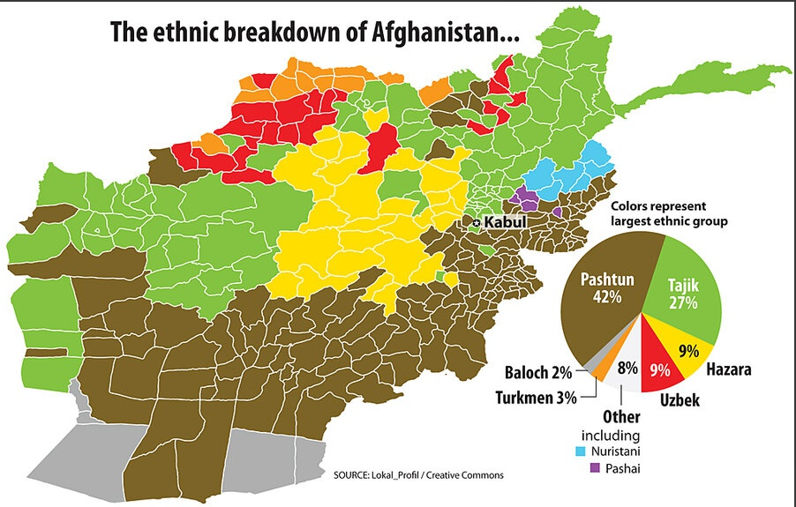

Slide 28
Rotary’s Endorsement of the Spread of Democracy
In an interview published in the April 2017 edition of The Rotarian, Steven Radelet, a development economist at Georgetown University, author of The Great Surge: The Ascent of the Developing World (2015), says “There has been more progress among the global poor over the last 25 years than at any time in human history.”
He says the “untold story” is of reductions in poverty, increases in incomes, improvements in health, and expansions of freedom around the world.”
The advances, he says are enormous, including reduction in conflict and war and spread of democracy.

Slide 29
Afghanistan, Pakistan and the Eradication of Polio
Rotary was a pioneer in the fight against polio and started efforts in 1978 with a very ambitious goal to reach a polio-free world.
Today, the wild poliovirus is endemic in two countries, Pakistan and Afghanistan.
In 2022 in Afghanistan the wild poliovirus type 1 (WPV1) left two children paralyzed, whereas in Pakistan, 20 children were affected by the virus.
In 2011, during Ball State’s partnership with Kandahar University, funded by the U.S. State Department, we helped Kandahar University provide 100 student interns to the World Health Organization to vaccinate children in the southeastern provinces of Afghanistan.

Slide 30
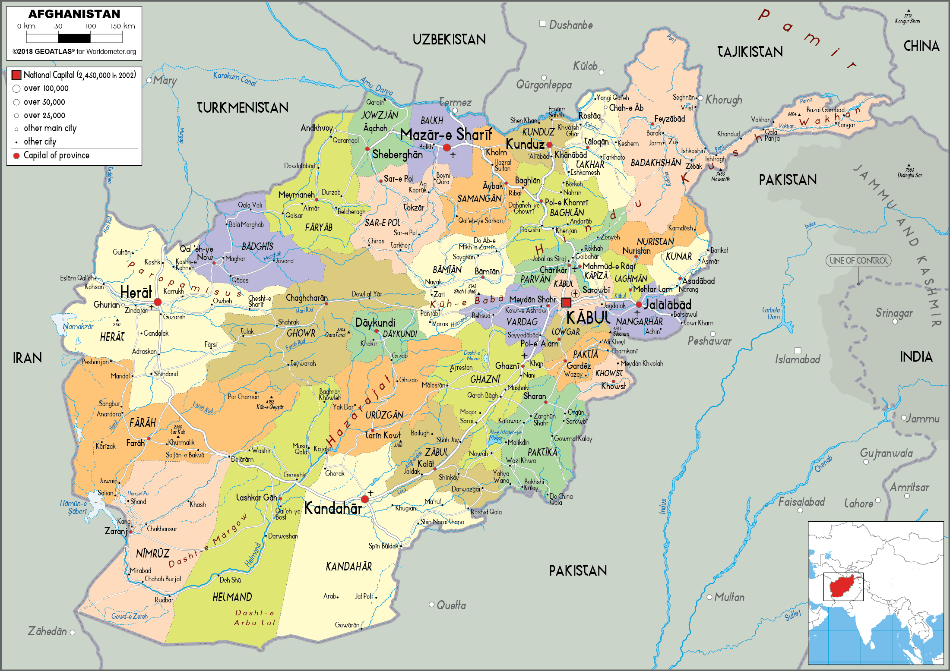

Slide 31
Conclusion
Democracy, freedom and prosperity in the developing world can only be achieved with the assistance of the United States.
Transition from authoritarianism to popular rule requires the education of leaders who understand and are committed to the principles of liberal democracy.
Rotary clubs, such as the one in Iowa City, Iowa, support democracy through such activities as a Rotary Working Conference in 2022 entitled “Democracy Under Fire: Support Ukraine and Democracy in Eastern Europe.”
Perhaps your club will organize similar activities to support people’s aspirations for freedom and prosperity in the developing world.

Slide 32
DALE BASHAM
Emcee

Slide 33
General Session 2

